Slide 1
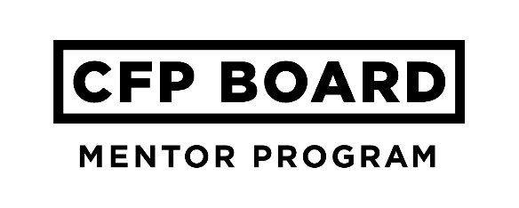
mentor Success Kit

Slide 2
Mentoring objectives
Thank you for volunteering as a CFP® professional mentor!
The CFP Board Mentor Program is designed to help candidates stay on track while studying for the CFP® exam. Your role supporting your mentee is incredibly valuable as you encourage and guide them through exam preparation.
Your Objectives as a Mentor:
Build a supportive relationship with your mentee focused on exam preparation over a four month period.
Be an accountability partner to help your mentee stay on track with their studying plan.
Review and understand the resources available to your mentee and guide them to effectively use these resources to develop and execute their exam preparation plan.
Help your mentee understand the best practices of successful exam takers.

Slide 3
Your Next Steps
Below are your mentoring responsibilities to ensure a successful relationship.
Respond to your mentor request invitations within seven days. You will receive mentoring requests from mentees when registration opens.
Have a minimum of three interactions (in person or virtually) with your mentee.
Focus your relationship on exam preparation. You will be working with your mentee for four months. We will formally end all mentoring relationships at the close of the July exam window.
Encourage your mentee to create a study plan and use our exam preparation resources.
We will provide additional resources and send you email tips to help you every step of the way!

Slide 4
Getting started

Slide 5
Tips for Your 1st Meeting
To help you get started, here is a suggested agenda for your 1st meeting with your mentee:
Introductions – introduce yourself so your mentee knows more about you and your background.
Cover your mutual understanding of the mentoring process and how you plan to help.
Discuss any boundaries of the relationship (confidentiality, etc.).
…continued on the next slide

Slide 6
Tips for your 1st Meeting
Make sure your mentee understands your role is to support them through their exam preparation process.
Go over areas your mentee is seeking the most help related to exam preparation.
Determine how often you will maintain contact with each other.
Establish times for regularly scheduled communications.

Slide 7
HOW TO BE SUCCESSFUL
To help set a framework for your mentoring relationship, here is how you can help your mentee be more successful:
Research shows those who follow their study plan are more likely to pass the exam. Review your mentee’s study plan and schedule, and establish regular check-ins to help them stay accountable.
Encourage your mentee to take the CFP Board Practice Exam. This is a free resource for all exam takers. 69% of those who passed the CFP® exam used the CFP Board Practice Exam as part of their study program. Have your mentee share their progress on the practice exam with you.

Slide 8
Based on research, those who passed the exam were significantly more likely to study 11-15 hours per week. Does your mentee’s study plan align with this?
Encourage your mentee to take a review course. Those who passed the exam said the two best ways to prepare were taking a review course and focusing on practice questions.

Slide 9
Helpful resources
Additional resources relating to mentoring can be found in the Mentor Program Resource Library.
You may get questions about the certification process that you’re not sure how to answer. Encourage your mentee to post their questions to CFP Board’s Candidate Forum. This is an online community exclusively for candidates where they can connect, ask questions, and get helpful responses from their peers.
Do you think your mentee would benefit from a one-on-one conversation about a certain element of certification? Let them know they can contact the CFP Board Stakeholder Services team at 1-800-487-1497.
We look forward to working with you to make your mentoring relationship successful. Please keep in touch! If you have any questions, please call Taylor Fealy, 202-379-2257 or email her at tfealy@cfpboard.org.

